Slide 1
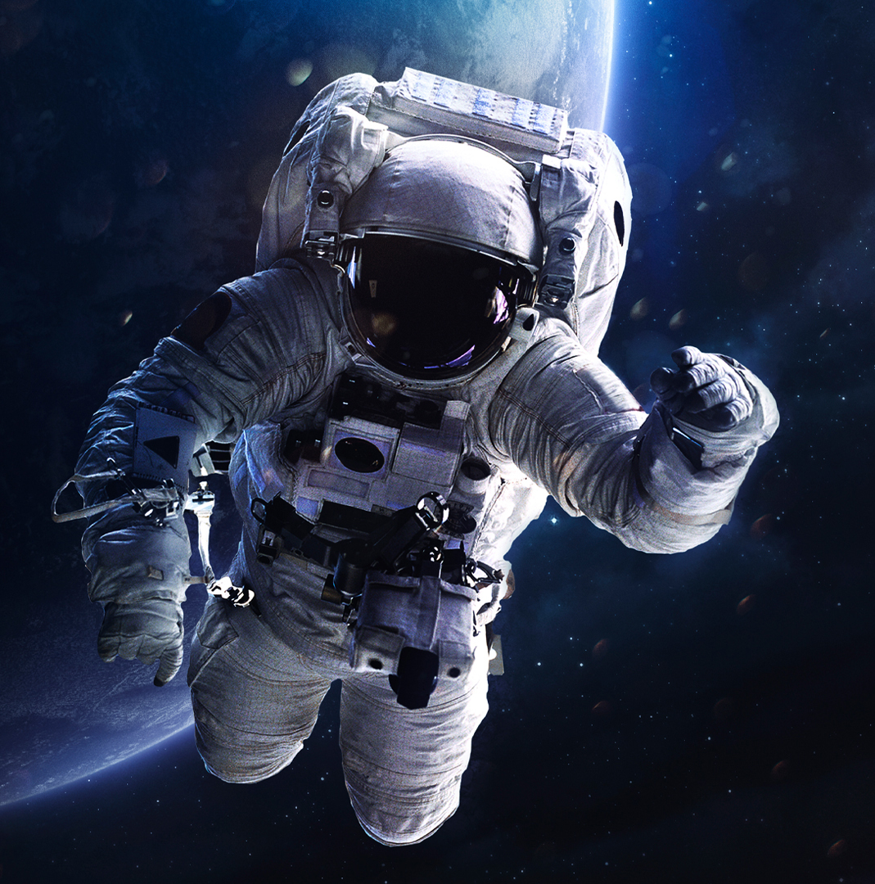
When the wise man points to the ISS
Direction and calculation team
Alex Zakaluzhskii & Mathilde Rossier
Notes:
Hello everyone. Alex and myself worked on the Direction and Calculation part. We divided the work in two parts. Alex worked on the iss trajectory and I worked on the eart vectors, coordinate systems and angles equations. To begin with our presentation, I’ll let Alex explain his part.

Slide 2



















How to find the initial data
$$\vec{c}$$
$$z=z_{F}$$
Keplerian elements: $\vec{q}\left(h,e,ω,Ω,i,u\right)$
$$i$$
$$\vec{h^{0}}$$
$$\vec{V}$$
Coordinates in J2000 system: $\vec{r}\left(x,y,z\right),\vec{V}\left(V_{x},V_{y},V_{z}\right)$
$$℧$$
$$\vec{r}$$
ISS
Coordinates in Fixed(Greenwich) system: $\vec{r_{F}}\left(x,y,z\right),\vec{V_{F}}\left(V_{x},V_{y},V_{z}\right)$
$$u$$
$$θ$$
$$π$$
$$Ω$$
$$ω$$
$$\vec{e}$$
KE_vector.txt
KE_ASK.py
ASKinit_vector.txt
$$y_{F}$$
$$α$$
$$α$$
$$y$$
scheduler.py
tick.txt
Int.py
$$x$$
$$x_{F}$$
GSK_vector.txt
ASK_GSK.py
ASK_vector.txt

Slide 3
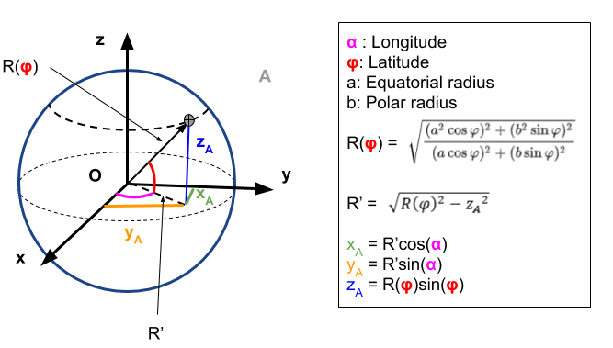
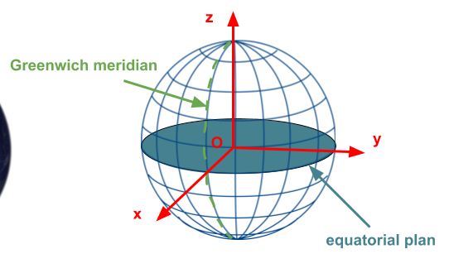
Earth vectors
Notes:
The first step of my part was to find the position vectors of the ISS tracker on earth. To do so we worked with a coordinates system that turns with the earth so that we have the sensation that the earth don’t rotate and the coordinates of the tracker never change. To find these coordinates, we need the latitude, longitude and radius of the place on earth where iss tracker is. Then it’s simple trigonometry to find the vector.

Slide 4
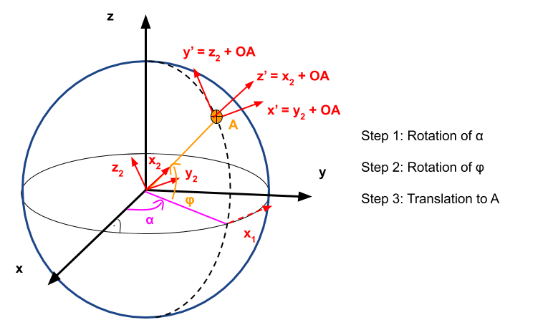
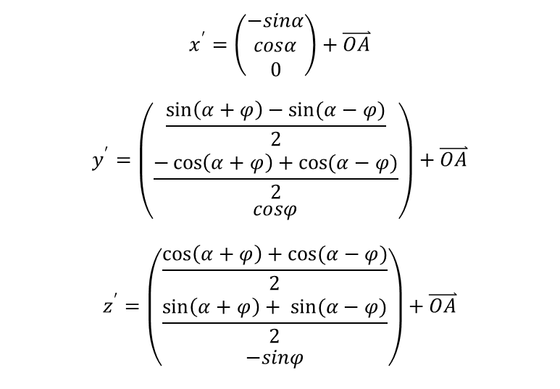
Local coordinates system
$$x^{′}=\left(\begin{matrix}−sinα \\ cosα \\ 0\end{matrix}\right)+\overset{⃑}{OA}$$
$$y^{′}=\left(\begin{matrix}\frac{\sin\left(α+φ\right)−sin(α−φ)}{2} \\ \frac{−\cos\left(α+φ\right)+cos(α−φ)}{2} \\ cosφ\end{matrix}\right)+\overset{⃑}{OA}$$
$$z^{′}=\left(\begin{matrix}\frac{\cos\left(α+φ\right)+cos(α−φ)}{2} \\ \frac{\sin\left(α+φ\right)+ sin(α−φ)}{2} \\ −sinφ\end{matrix}\right)+\overset{⃑}{OA}$$
Notes:
The second step is to define a local coordinates system at the point on earth where the tracker is. The new basis vectors are defined through two rotations and one translation. We need this basis so that we can calculate the angles between the tengential plane and the iss vector that is given by alex program. The iss vector is also transformed in the new coordinates system.

Slide 5
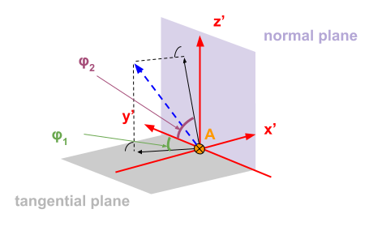
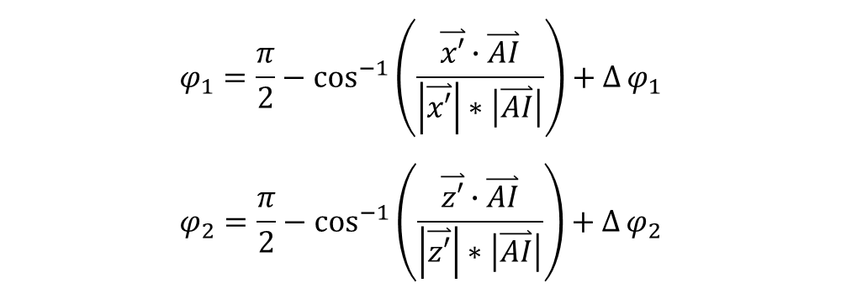
Angles calculation
$$φ_{1}=\frac{π}{2}−\cos^{−1}\left(\frac{\overset{⃑}{x′}∙\overset{⃑}{AI}}{\left|\overset{⃑}{x′}\right|∗\left|\overset{⃑}{AI}\right|}\right)+∆φ_{1}$$
$$φ_{2}=\frac{π}{2}−\cos^{−1}\left(\frac{\overset{⃑}{z′}∙\overset{⃑}{AI}}{\left|\overset{⃑}{z′}\right|∗\left|\overset{⃑}{AI}\right|}\right)+∆φ_{2}$$
Notes:
Once we have the new basis and the iss vector expressed in it, the angles are obtained through a simple formula. The last thing to controll are the initial angles and the position of the north the correct the angles. That’s the deltas in the formulas.

Slide 6
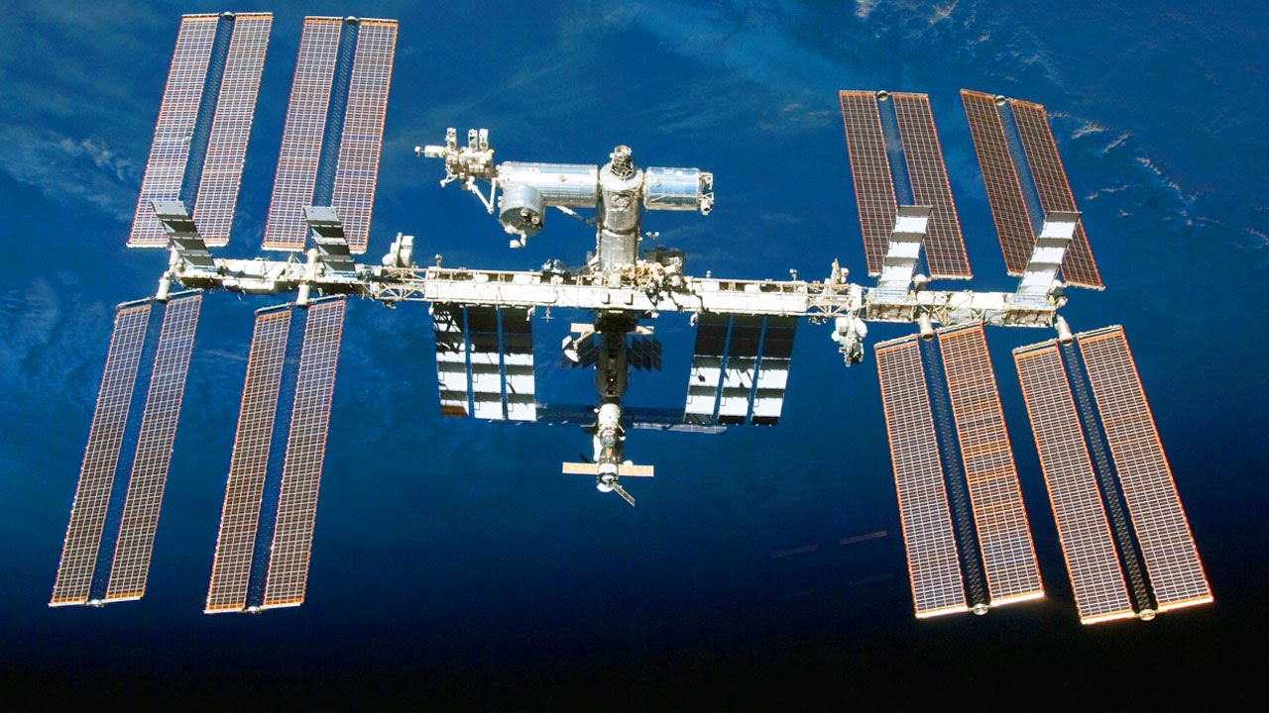
Thank you for your attention

Slide 7
Sources
Pic1:
Last pic:
Cette photo par Auteur inconnu est soumise à la licence CC BY-ND
Cette photo par Auteur inconnu est soumise à la licence CC BY

